Slide 1

BABEȘ-BOLYAI UNIVERSITY
FACULTY OF BUSINESS
THE IMPORTANCE OF BUSINESS INTELLIGENCE SOLUTIONS IN HOSPITALITY DATA ANALYSIS
Scientific coordinator
Conf.univ.dr. Rozalia Veronica-Rus
Graduate
Octav Badiu

Slide 2





THE IMPORTANCE OF BUSINESS INTELLIGENCE SOLUTIONS IN HOSPITALITY DATA ANALYSIS
SUMMARY
AIM AND OBJECTIVES OF THE THESIS
METHODOLOGY USED
RESULTS OBTAINED
CONCLUSIONS

Slide 3
THE IMPORTANCE OF BUSINESS INTELLIGENCE SOLUTIONS IN HOSPITALITY DATA ANALYSIS
PURPOSE OF WORK
The aim of the paper is to highlight how data analytics can be applied in the hospitality industry.

Slide 4
THE IMPORTANCE OF BUSINESS INTELLIGENCE SOLUTIONS IN HOSPITALITY DATA ANALYSIS
Objectives of the work:
Defining and exemplifying data analysis in the context of the hospitality industry:
Data analytics improves customer experience by personalising services
Hotels can use data analytics to understand customer preferences
Personalised recommendations - Massage services or outdoor activities

Slide 5
THE IMPORTANCE OF BUSINESS INTELLIGENCE SOLUTIONS IN HOSPITALITY DATA ANALYSIS
Presentation of relevant case studies on the use of data analytics in the hospitality industry:
Hilton Worldwide used data analytics to improve guest experience
Room View virtual reality (VR) platform offered by Hilton Worldwide
This innovation increases guest satisfaction

Slide 6
THE IMPORTANCE OF BUSINESS INTELLIGENCE SOLUTIONS IN HOSPITALITY DATA ANALYSIS
ADVANTAGES OF BUSINESS INTELLIGENCE SOLUTIONS
Highlighting the advantages and benefits that data analytics brings to the hospitality industry:
Improving customer experience
Customised services
Operational efficiency
Data-driven decision-making

Slide 7
THE IMPORTANCE OF BUSINESS INTELLIGENCE SOLUTIONS IN HOSPITALITY DATA ANALYSIS
lV. Analysis of relevant key performance indicators in the hospitality industry:
RevPAR (Revenue per Available Room)
ADR (Average Daily Rate)
CAS (Cost per Available Seat)
(Occupancy Rate)

Slide 8
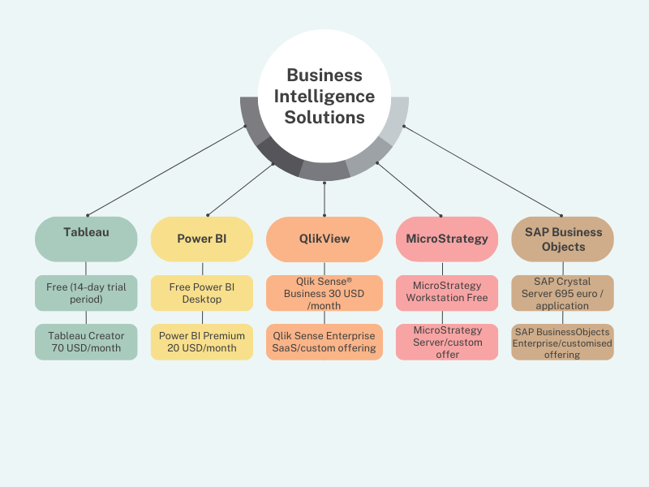
THE IMPORTANCE OF BUSINESS INTELLIGENCE SOLUTIONS IN HOSPITALITY DATA ANALYSIS
V. Presenting the business intelligence solutions available for the hospitality industry:

Slide 9
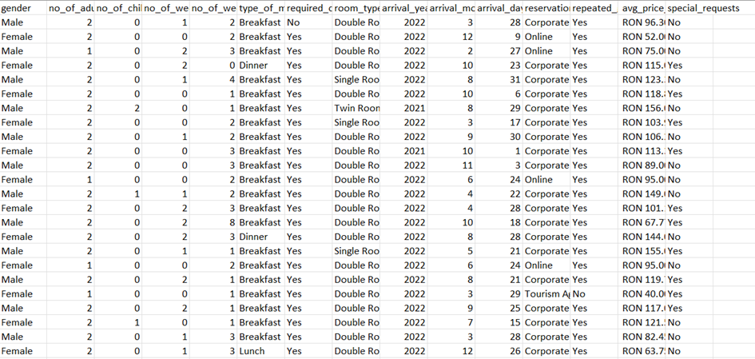
THE IMPORTANCE OF BUSINESS INTELLIGENCE SOLUTIONS IN HOSPITALITY DATA ANALYSIS
METHODOLOGY
The methodology involved collecting data from the "Hotel Dataset.csv" database on Kaggle and processing it using Power BI.

Slide 10
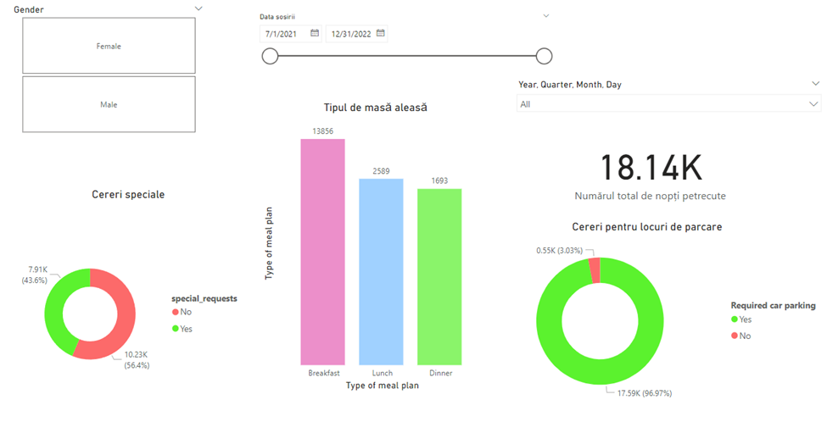
THE IMPORTANCE OF BUSINESS INTELLIGENCE SOLUTIONS IN HOSPITALITY DATA ANALYSIS
RESULTS
Dashboard Page 1

Slide 11
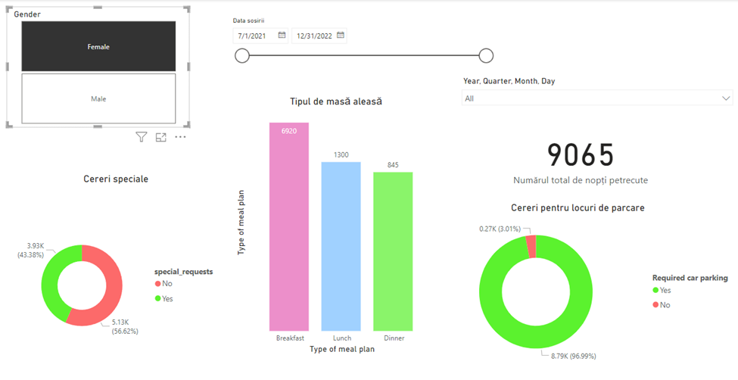
THE IMPORTANCE OF BUSINESS INTELLIGENCE SOLUTIONS IN HOSPITALITY DATA ANALYSIS
Gender selection

Slide 12
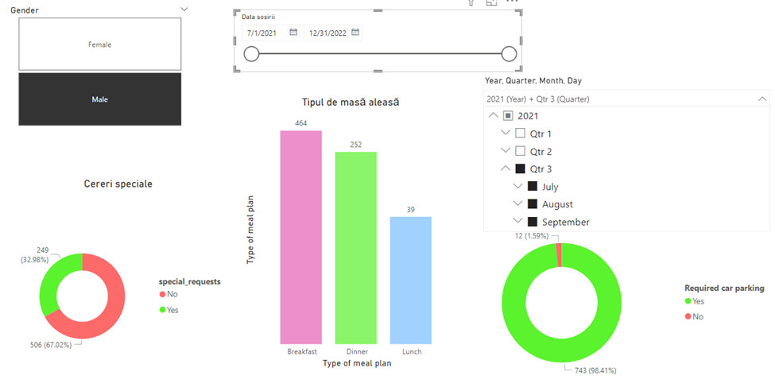
THE IMPORTANCE OF BUSINESS INTELLIGENCE SOLUTIONS IN HOSPITALITY DATA ANALYSIS
Select period, year, month

Slide 13
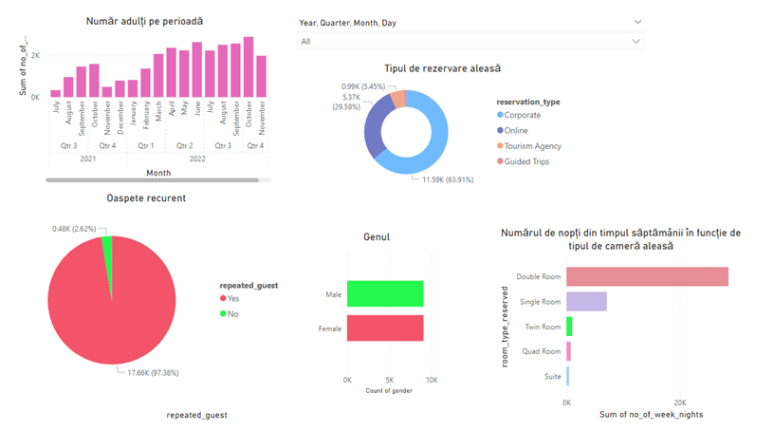
THE IMPORTANCE OF BUSINESS INTELLIGENCE SOLUTIONS IN HOSPITALITY DATA ANALYSIS
Dashboard Page 2

Slide 14
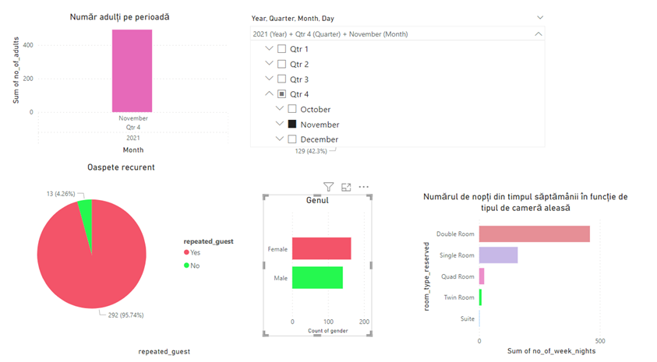
THE IMPORTANCE OF BUSINESS INTELLIGENCE SOLUTIONS IN HOSPITALITY DATA ANALYSIS
Select period, year, month

Slide 15
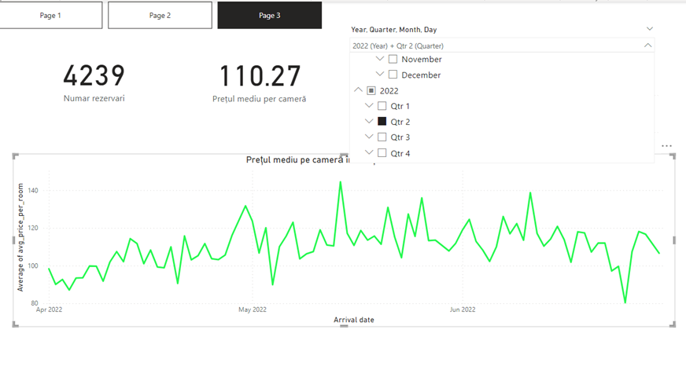
THE IMPORTANCE OF BUSINESS INTELLIGENCE SOLUTIONS IN HOSPITALITY DATA ANALYSIS

Slide 16
THE IMPORTANCE OF BUSINESS INTELLIGENCE SOLUTIONS IN HOSPITALITY DATA ANALYSIS
CONCLUSIONS
BI solutions are vital in the hospitality industry
BI solutions provide deep customer insight
Data analytics help personalize the customer experience
BI solutions help hotels make strategic decisions
BI is essential in hospitality for long-term success

Slide 17

THE IMPORTANCE OF BUSINESS INTELLIGENCE SOLUTIONS IN HOSPITALITY DATA ANALYSIS
THANK YOU FOR YOUR TIME!
Scientific coordinator
Conf.univ.dr. Rozalia Veronica-Rus
Graduate
Octav Badiu

